Slide 1


Alexandre Leblanc-Richard
2023-04-16

Slide 2

Outline
Executive Summary
Introduction
Methodology
Results
Conclusion
Appendix

Slide 3
Executive Summary
Space Y wishes to determine the best parameters for a successful landing
To determine these parameters, a series of analysis was performed using data available from the Space X Rest API and the Space X Wikipedia page
The data was preprocessed to format it and fill missing values
Analysis were performed with visuals using Pandas dataframes in Python and also using the sqlalchemy library with a db2 database
A plotly dashboard was built to visualize the data interactively
Folium maps were created to visualize the locations of the different launch sites around the USA, and to determine the proximities
With this analysis, we have been able to determine two factors that appear to impact the success of a landing:
Launching from the Kennedy Space Center
Using one these orbits in conjunction with a payload mass below 6,000 kg: ES-L1, GEO, HEO and SSO
The VLEO orbit also has a high success rate with payloads greater than 13,000 kg
We then tested four different machine learning models to determine which would best predict the outcome of a landing
All four models tested yielded the same accuracy on the testing data, at 83%
The best model that was identified is the decision tree classifier, with an accuracy of 89% on the training data

Slide 4
Introduction
Project background and context
Many companies wish to make commercial space flights available and affordable
One of the most successful => Space X
Can reuse the expensive first stage, cutting costs by more than half ($165M vs $62M per launch)
Depending on mission parameters, the first stage can land successfully, crash or be sacrificed
Space Y wants to compete with Space X using Space X’s results to determine the best course of action
Problems you want to find answers to
Using a machine learning model, can we predict the outcome of a flight given certain parameters
Can we identify optimal parameters for a successful launch

Slide 5

Section 1

Slide 6
Methodology
Executive Summary
Data collection methodology:
Space X Rest API
Wikipedia page on Space X Falcon 9 Heavy Launches
Perform data wrangling
Filtering and filling missing values
Add landing class to the data
Perform exploratory data analysis (EDA) using visualization and SQL
Perform interactive visual analytics using Folium and Plotly Dash
Perform predictive analysis using classification models
GridSearch CV
Bar chart to rank models

Slide 7
Data Collection – SpaceX API
Import libraries and create useful functions
Request the data from the URL (json)
Convert the json into a Pandas dataframe
Get information about each launch using the ID and the custom functions
Construct the dataset and convert it to dataframe
Filter to keep only the Falcon 9 launches
Fill missing values using the average (for the Payload mass)
Export the data to a CSV
Extraction was performed using the SpaceX API to get information about the Falcon 9 launches
We used the Request library in Python to query the API and construct the dataset
Link: https://github.com/AlexandreLR/CapstoneProjet/blob/579947c7ac412eb9b24f404360d0a7b0b0605b3f/Data%20collection.ipynb

Slide 8
Data Collection – Web scraping
Import libraries and create useful functions
Use the Request library to get the content of the page and create a BeautifulSoup object
Extract the column headers/variable names from the table header
Parse the launch tables to get the different information and store the contents in a dictionnary
Convert the dictionary into a dataframe and export as a CSV
Extraction was performed from the Wikipedia page
We used the Request and BeautifulSoup libraries in Python to extract the data from the HTML tables in the page
Link: https://github.com/AlexandreLR/CapstoneProjet/blob/579947c7ac412eb9b24f404360d0a7b0b0605b3f/Data%20collection%20-%20Web%20scraping.ipynb

Slide 9
Data Wrangling
Import libraries the previously extracted data
Explore some statistics on the data: number of launch by site, by orbit and by mission outcome
For the mission outcome, create a set of bad outcomes
Using the bad outcome set, add a landing_class variable (1 or 0)
Export data into CSV format
Data contains different types of mission outcomes
Need to convert these string outcomes into labels we can use for training (1 for success, 0 for failure)
Link: https://github.com/AlexandreLR/CapstoneProjet/blob/579947c7ac412eb9b24f404360d0a7b0b0605b3f/Data%20wrangling.ipynb

Slide 10
EDA with Data Visualization
Plotted charts:
Scatter plots to show the relation and present any potential correlation between the variables
Payload mass vs flight number
Launch site vs flight number
Launch site vs payload mass
Orbit vs flight number
Orbit vs payload mass
Bar chart to compare success rate by orbit
Line chart to show the evolution of the success rate over the years
Link: https://github.com/AlexandreLR/CapstoneProjet/blob/6e0c996875a17000371bf832d191715f7519ee6f/EDA%20with%20Data%20Visualization.ipynb

Slide 11
EDA with SQL
List of queries performed
Names of the different launch sites
Display 5 records for launch sites starting with CCA (using LIKE and wildcard “%”)
Total payload mass carried by boosters launched by NASA
Average payload mass for the Falcon 9 booster version 1.1
List the boosters with success for landing on drone ships with a payload mass between 4,000 and 6,000 kg
List the total number of mission outcomes by outcome type (success or failure)
List of booster version that carried the maximum payload mass
List the records which will display the month names, failure landing_outcomes in drone ship ,booster versions, launch_site for the months in year 2015
Rank the count of successful landing_outcomes between the date 04-06-2010 and 20-03-2017 in descending order
Link: https://github.com/AlexandreLR/CapstoneProjet/blob/3b8e3b9d60e068326eda4ae4ace226cfcc348bd2/EDA%20with%20SQL.ipynb

Slide 12
Build an Interactive Map with Folium
Add map markers for launch sites to view the location of all the launch sites
Mark success and failures by launch site by adding a MarkerCluster object. This allows to quickly view which sites have the most success
Calculate the launch site distance to its proximities using a map marker and an icon to show the distance on the map along with a line. This will allow us to determine where an ideal launch site should be positionned
Link: https://github.com/AlexandreLR/CapstoneProjet/blob/dcd76cf82edb4ed1b3a2a1515b3cbaada81b9fe5/Interactive%20Visual%20Analytics%20with%20Folium%20lab.ipynb

Slide 13
Build a Dashboard with Plotly Dash
Added a pie chart to show the success rate by launch site to determine which launch site has the most success
Added a scatter plot to show the relation between then payload mass, the success rate and the booster version. This allows us to determine which version of the booster is best suited for each payload mass category.
Both visuals can be filtered by launch site for more details
Link: https://github.com/AlexandreLR/CapstoneProjet/blob/9411639f541e755bfac61b073234865ca83f625f/spacex_dash_app.py

Slide 14
Predictive Analysis (Classification)
Import libraries and create a function to plot the confusion matrix
Import the data and perform a standard scaling
Split the data into training and testing sets (80-20)
Test 4 models using GridSearch: Logistic regression, SVM, decision tree, KNN
Calculate the accuracy score for the test data
Plot the accuracy scores for all models, for both the training and testing data
Determine the best model given the accuracy score
Plot a confusion matrix for each model
Each model was tested using GridSearchCV and a list of different parameters depending on the model used
Link: https://github.com/AlexandreLR/CapstoneProjet/blob/0299a11386718c1d99b3de5d9f6e6b440cfdb007/Machine%20learning%20prediction%20lab.ipynb

Slide 15
Results
Exploratory data analysis results
Interactive analytics demo in screenshots
Predictive analysis results

Slide 16

Section 2

Slide 17
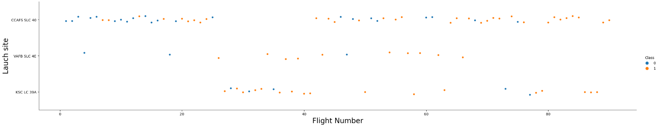
Flight Number vs. Launch Site
Early flights for CCAFS-SLC-40 => Low success rate
After 20th flight => Success rate increased
No failed flights after the 80th flight

Slide 18
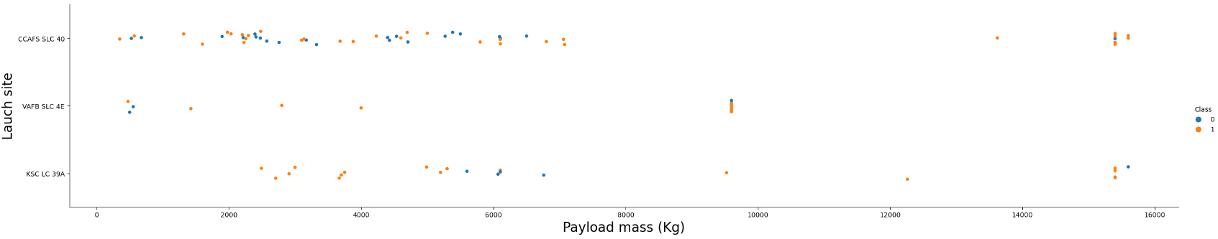
Payload vs. Launch Site
The site VAFB SLC 4E has not launched payloads with as mass greater than 10,000 kg
The success rate appears to be higher for payload masses above 10,000 kg
KSC-LC-39A had only one failures for payload masses below 6,000 kg

Slide 19
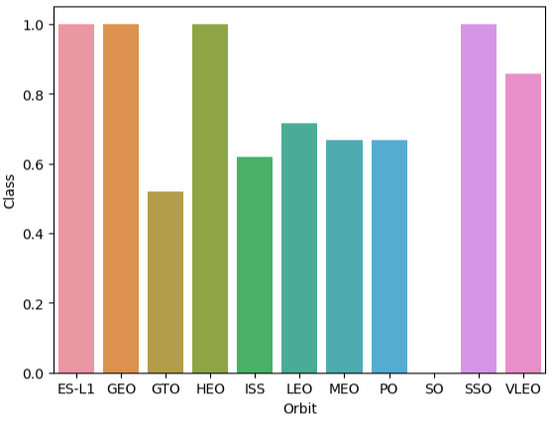
Success Rate vs. Orbit Type
ES-L1, GEO, HEO and SSO have the highest success rates (100%)
Need to confirm in multiple launches for these orbits (see next slide)
GTO has the lowest success rate

Slide 20
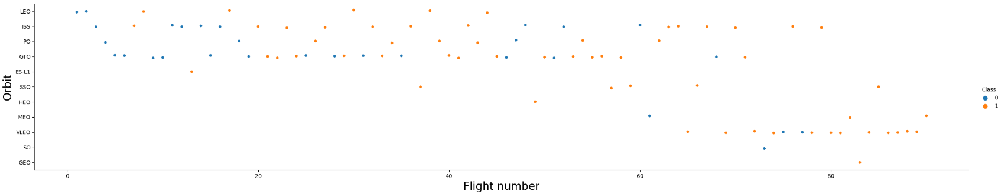
Flight Number vs. Orbit Type
LEO and PO orbits’ success rate appear to be related to the flight number, while for other orbits the correlation is not as pronounced
Some orbits only have very few flights (such as HEO, SO or GEO), which explains some high or low success rates

Slide 21
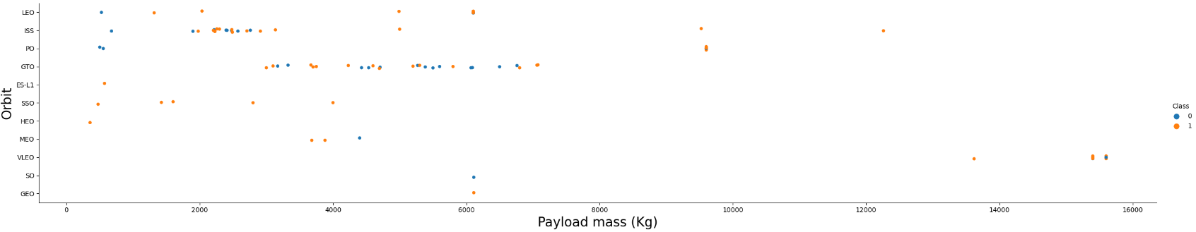
Payload vs. Orbit Type
aaa

Slide 22
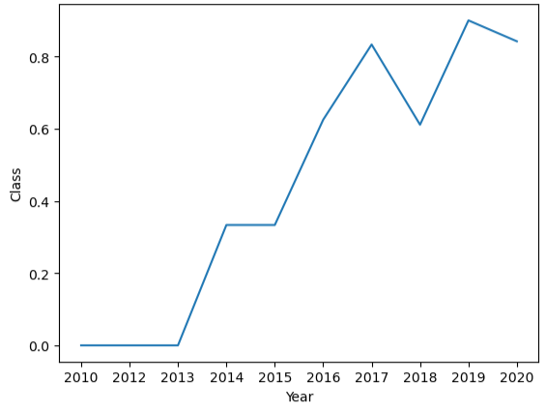
Launch Success Yearly Trend
The success rate since 2013 increased each year except in 2018, which saw a decrease

Slide 23
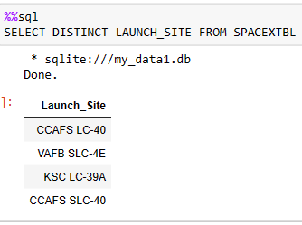
All Launch Site Names
There are a total of 4 launch sites used by Space X:
2 in Cape Canaveral Launch Complex, Florida
CCAFS LC-40
CCAFS SCL-40
1 at the Kennedy Space Center, Florida
KSC LC-39A
1 at the Vadenberg Space Launch Complex (California)
VAFB SLC-4E

Slide 24
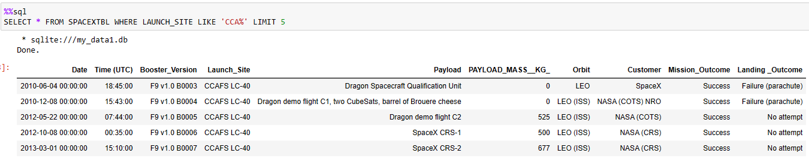
Launch Site Names Begin with 'CCA'
Out of first five launches in Cape Canaveral, all missions were successful
In 3 out 5 mission, no landing was attempted, while in the other 2 the landing was a failure

Slide 25
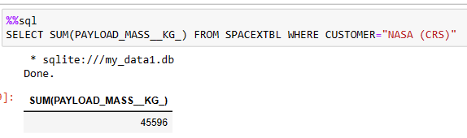
Total Payload Mass
The total payload mass carried for NASA (CRS) was 45,596 kg

Slide 26
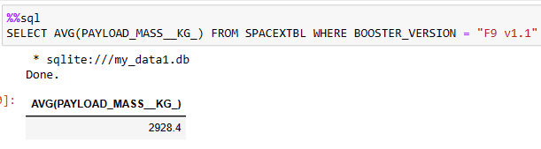
Average Payload Mass by F9 v1.1
The average payload mass for the Falcon 9 booster version 1.1 was 2,928 kg

Slide 27
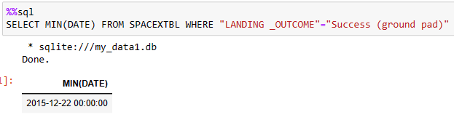
First Successful Ground Landing Date
The first successful landing on a ground pad was in December of 2015, on the 22nd

Slide 28
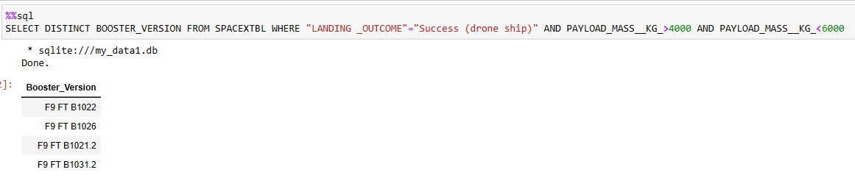
Successful Drone Ship Landing with Payload between 4000 and 6000
For payload masses between 4,000 and 6,000 kg, 4 booster version had successful landings on a drone ship

Slide 29
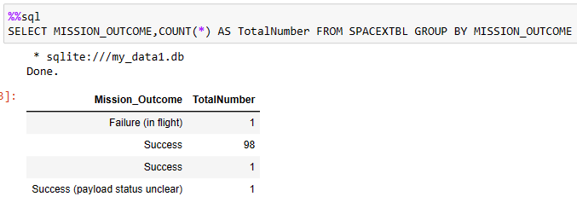
Total Number of Successful and Failure Mission Outcomes
Out of all the mission outcomes (not landing outcome), 99 were success, while only 2 appear to have had issues (1 failure in flight and 1 were the status of the payload is unclear)

Slide 30
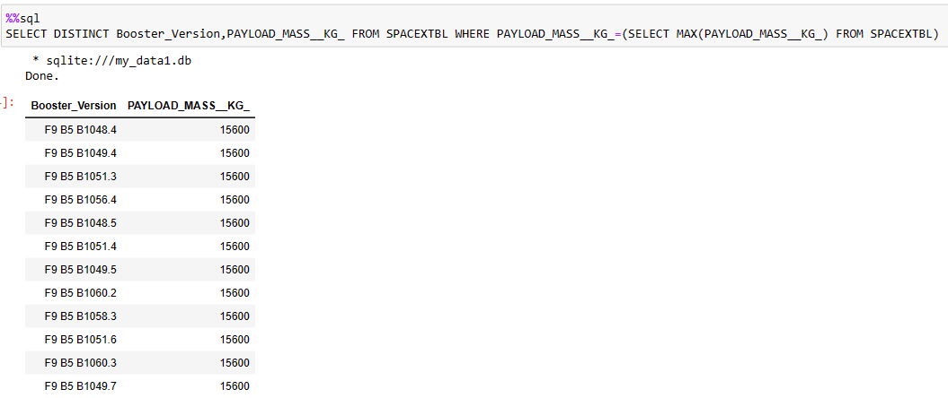
Boosters Carried Maximum Payload
The maximum payload mass carried by a Space X booster was 15,600 kg
Here is a list

Slide 31
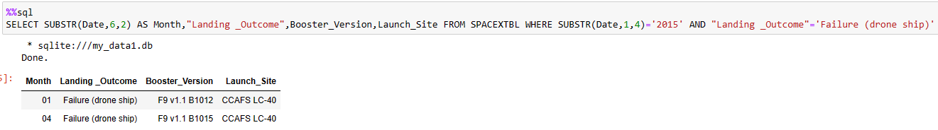
2015 Launch Records
In 2015, 2 missions had failed landings on a drone ship (one in January and one in April)
The 2 were launched from Cape Canaveral Launch Complex 40
There were 2 booster version: F9 v1.1 B1012 and F9 v1.1 B1015

Slide 32
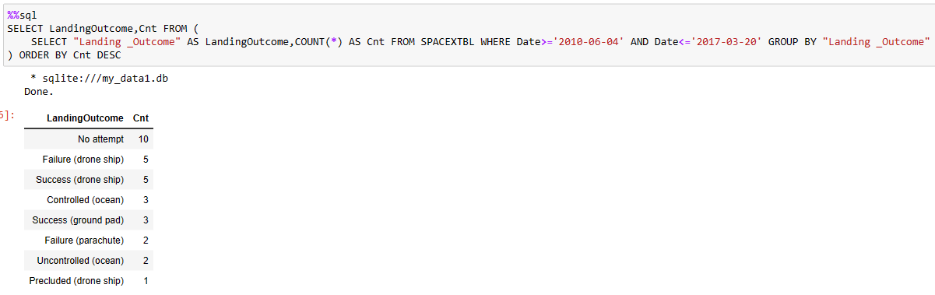
Rank Landing Outcomes Between 2010-06-04 and 2017-03-20
Between June 4, 2010 and March 20, 2017, there were a total of 31 flights
10 had no attempted landings and 7 were failures
50% of the drone ship landings failed

Slide 33

Section 3

Slide 34
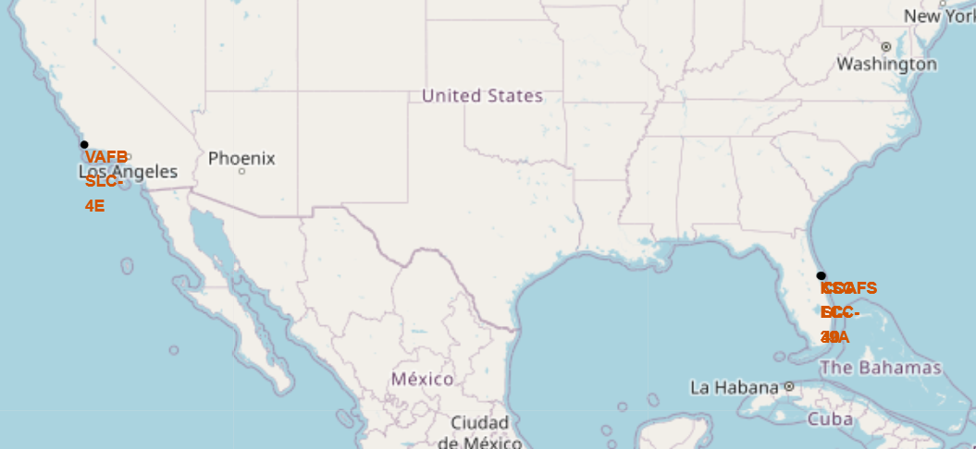
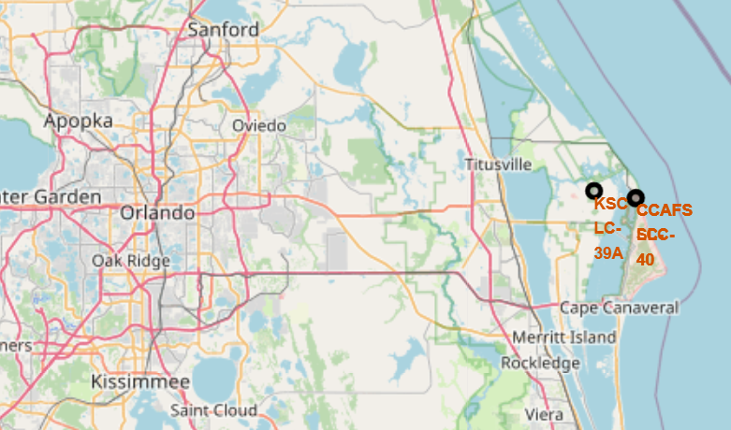
Launch site locations
Launch sites are primarily located on coasts
One launch site on the west coast and 3 on the east coast
Launch sites are in proximity of the equator

Slide 35
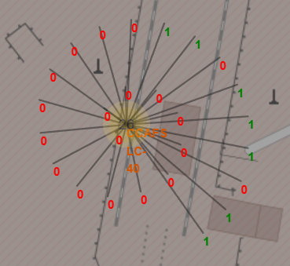
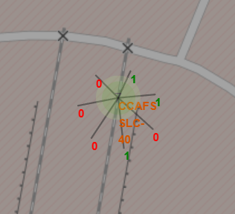
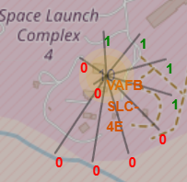
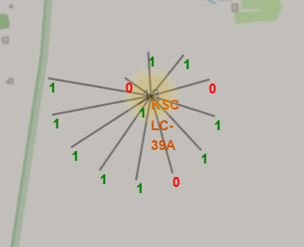
Launch outcomes by launch site
CCAFS-LC-40
CCAFS-SLC-40
Added labels for each of the launch by launch site to show the mission outcomes
KSC-LC-39A has the most successful launch of all site
CCAFS-LC-40 has the most failed launches
KSC-LC-39A
KSC-LC-39A

Slide 36
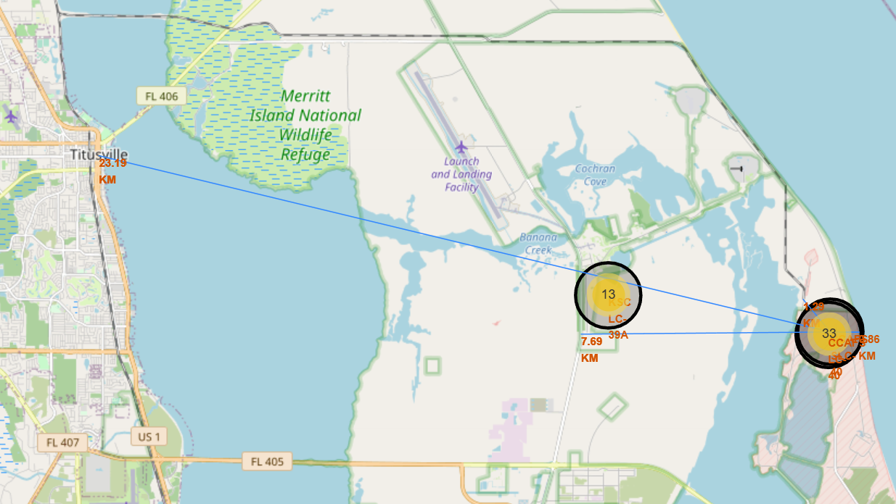
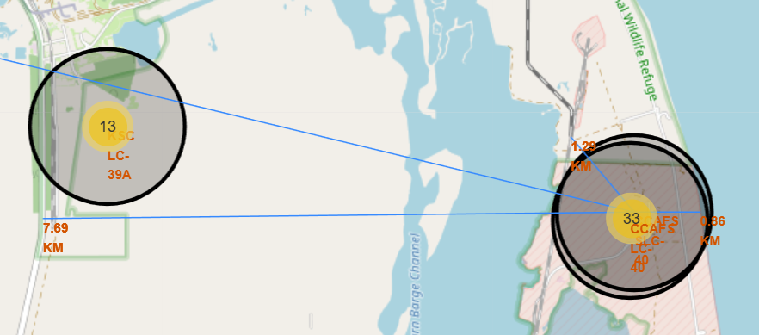
Launch site proximities
The launch sites are located close to the ocean, with a 0.86 km distance for CCAFS-SLC-40
Also close to railways (1.23 km)
Situated relatively far from cities (23.19 km from Titusville)
Hard to conclude whether or not launch sites are close to highways (7.69km for CCAFS-SLC-40, but much closer to KSC-LC-39A)

Slide 37

Section 4

Slide 38
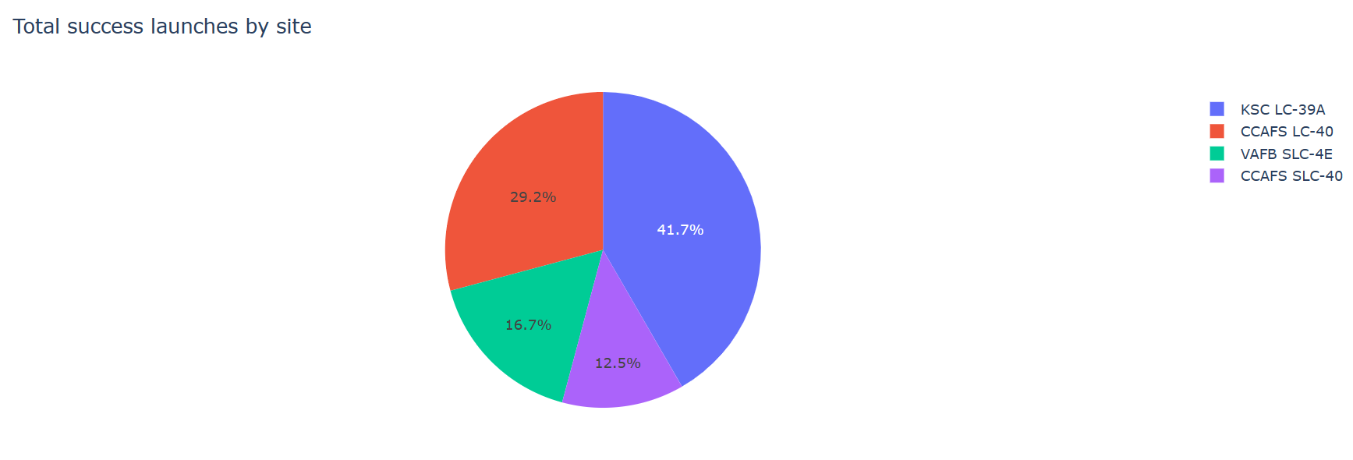
Success by launch sites
KSC LC-39A has the highest success rate of all sites, which confirms what we saw in the Folium map before

Slide 39
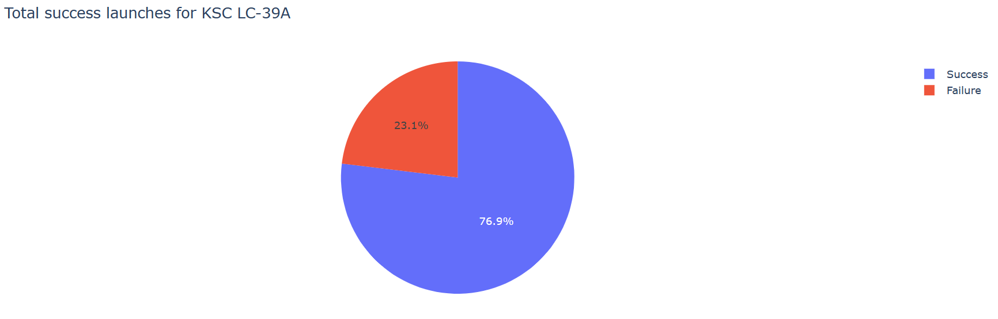
Success rate for KSC LC-39A
KSC LC-39A has over 75% success launches

Slide 40
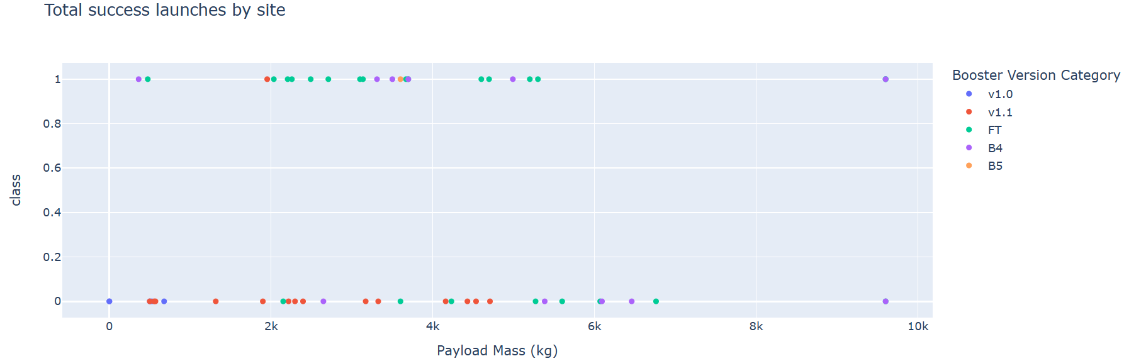
Success rate by payload mass and booster version
FT booster version has a high success rate for payloads under 6,000 kg
The v1.1 booster version has a low success rate regardless of the payload mass

Slide 41

Section 5

Slide 42
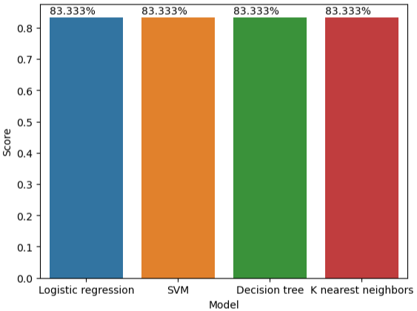
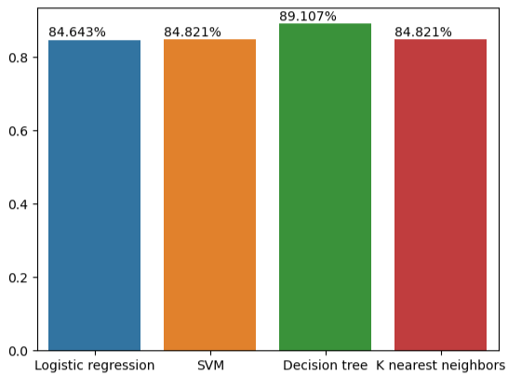
Classification Accuracy
Accuracy score – Test data
Accuracy score – Training data
Since all models had the same accuracy score on the test data, we had to turn to the accuracy of the training data to get the best model
Best model => Decision tree classifier

Slide 43
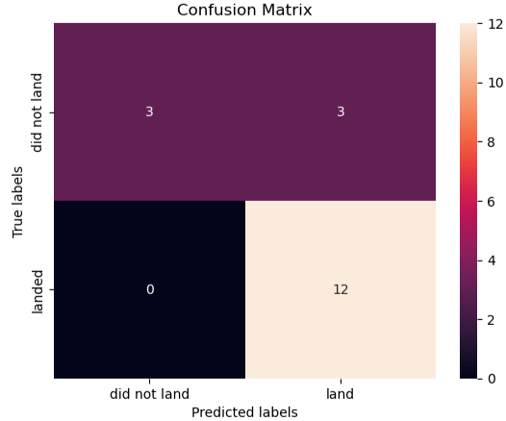
Confusion Matrix
The decision tree model is very good to predict a landing when one really occurred
It is however unable to accurately predict when the landing did not happen
50% of the time it predicted wrong

Slide 44
Conclusions
The questions we wanted answered were:
Can we predict the outcome of a launch using a machine learning model?
What are the optimal parameters for a successful landing?
Given all the data we had at our disposal, here at the conclusion of this study:
The best machine learning model is a decision tree classifier; however, the accuracy was not optimal to predict failures
The best parameters for a successful landing given the data analyzed appear to be:
Launching for the Kennedy Space Center (KSC LC-39A)
Using one these orbits with a payload mass lower then 8,000 kg: ES-L1, GEO, HEO and SSO
The VLEO orbit has a high success rate with higher payload masses (above 13,000 kg)
Years of experience are also required to have a successful landing, as shown when trending the success rate by year
A future research topic to further increase our knowledge and improve costs would be to create a model that can predict the cost of launch depending on the parameters

Slide 45


